Slide 1

Microsoft PowerPoint
Points of Power
Version <insert Month> 2019

Slide 2
Microsoft PowerPoint
Use a standard template
Use key points*
Use SmartArt graphics and images
Do not decorate
Keep it simple
* Words from legislation and regulations are an exception to this rule

Slide 3
Simple format and layout
Two levels of bullet points only
Font size
  Slide heading, 44 point, Calibri, Bold
  First level text, 40 point, Calibri
  Second level text 36 point Calibri
AutoFit will reduce font size automatically

Slide 4
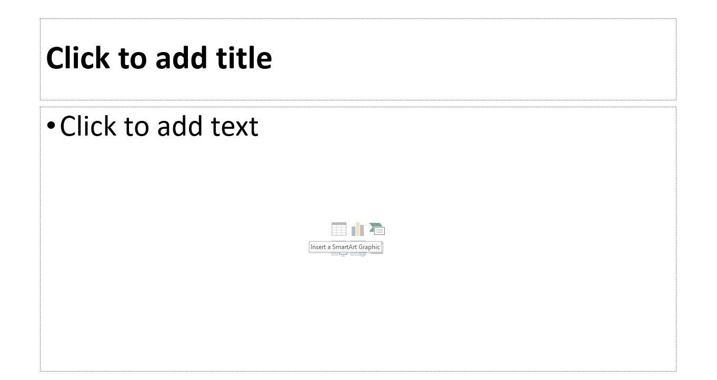
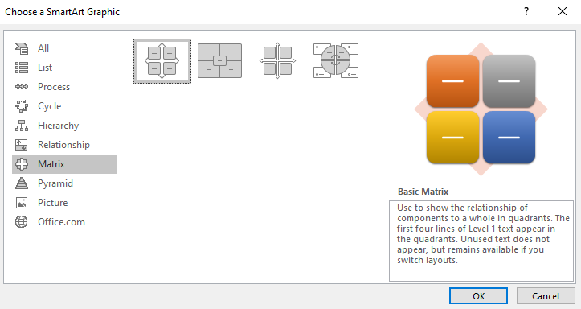

How to use SmartArt Graphics
Step 1
Select SmartArt Graphic
Step 2
Choose a SmartArt Graphic

Slide 5





Use tables to organise information
(the following is an example)
Icon | Type of SmartArt | Description of use
 | List | Use to show non-sequential or grouped blocks of information
 | Process | Use to show a progression or sequential steps
 | Cycle | Use to represent a continuing sequence or a circular flow
 | Hierarchy | Use to show hierarchical information or reporting relationships
 | Relationship | Use to show the relationship to a central idea
 | Matrix | Use to show the placement of concepts along two axes
 | Pyramid | Use to show proportional or hierarchical relationship

Slide 6
Two rules to remember
7 + 2 rule
Most adults can only store between 5 and 9 items in their short-term memory
10/20/30 rule
10 slides
20 minutes
30 point font size (minimum)

Slide 7

Royalty-free photos and icons
Use free photos
  Unsplash
  Pixabay
  Etc.
Use free icons
Make your own icons and photos
Photo by Mike Marrah on Unsplash
Version <insert Month> 2019

Slide 8
In summary
Use simple format and layout
Use appropriate SmartArt Graphics
Remember two rules
  7 + 2 rule
  10/20/30 rule
Use free photo and icons, or make your own

Slide 9
Microsoft PowerPoint
Points of Power
Version <insert Month> 2019

