Slide 1

Improving assessment moderation processes at my RTO
PD session
20-minute presentation
20-minute activity
Version April 2019

Slide 2
The VET assessment system
VET and Australia’s economic viability
Key features of the Australian VET system
  Industry-led
  National
  Client-focused
Competency-based
  Role of industry and enterprise
  Criterion referenced compared to norm referenced assessments

Slide 3
Compliance requirements
Standards for RTOs
Safety legislation and regulations
Industry-specific legislation and regulations
Other legislation and regulations; such as
  Anti-discrimination
  Privacy

Slide 4


Assessment is the gatekeeper of quality
Who holds the key?

Slide 5
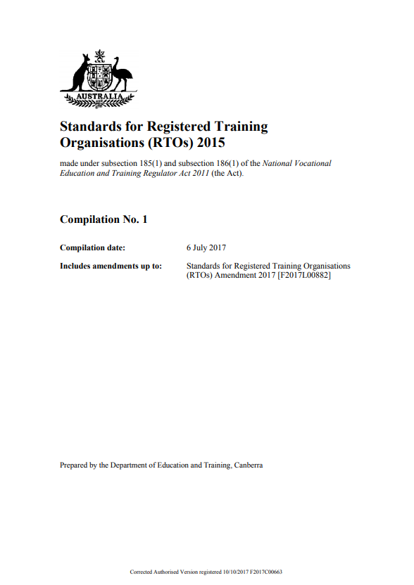
Standards for RTOs 2015
Clause 1.16
The RTO ensures that all trainers and assessors undertake professional development in the fields of the knowledge and practice of vocational training, learning and assessment including competency based training and assessment.
Clause 1.13
In addition to the requirements specified in Clause 1.14 and Clause 1.15, the RTO’s training and assessment is delivered only by persons who have:
a) vocational competencies at least to the level being delivered and assessed;
b) current industry skills directly relevant to the training and assessment being provided; and
c) current knowledge and skills in vocational training and learning that informs their training and assessment.

Slide 6
Professional development (PD) for assessors
Changes to the TAE Certificate IV
  Better skilled new entrants to the VET workforce
  New credentials for the existing VET workforce
Promote ethical practice (transparency and fairness)
Continuous improvement of assessment process and practice

Slide 7
Identifying the need for improvement
Areas for improvement
Assessment moderation
Internal and external audits
Assessment validation
Performance feedback*
* Includes complaints, appeals and suggestions for improvement from learners, assessors and RTO administrators

Slide 8
Assessment moderation
Difference between moderation and validation
Moderation policy and procedures
  Purpose
  Features
  Documentation requirements (inputs and outputs)
Systematic implementation of moderation at my RTO

Slide 9
PD activity
Instructions
Work as a group of assessors for 20 minutes
Review my RTO’s moderation policy and procedure
Identify improvements
  Improvements to the moderation policy and procedure
  Improvements to the assessment processes and practices

